Slide 1
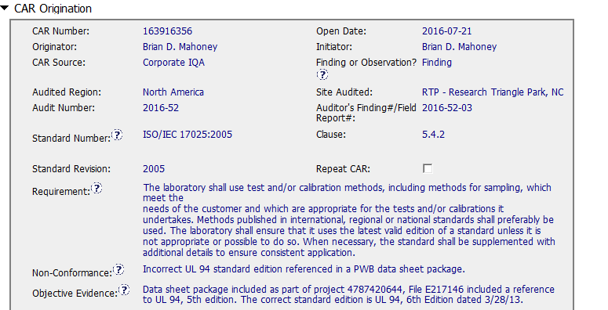
CAR 163916356 (finding)
Non-Conformance and objective evidence only as reference

Slide 2
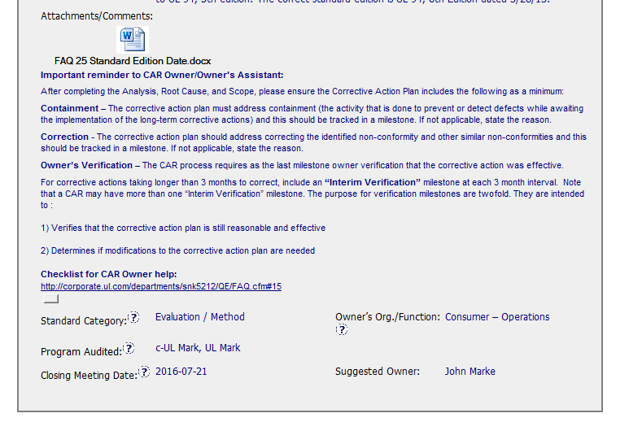
CAR 163916356 (finding)
Provides special guidance of the specific approach for this type of NC

Slide 3
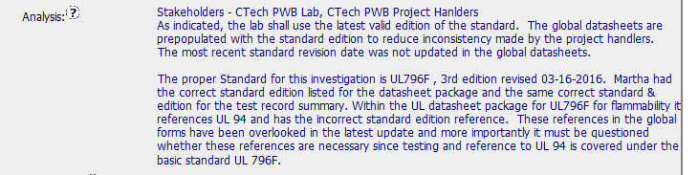
CAR 163916356 (finding)
Is the nonconformity fully addressed in the analysis?
Partially.
The analysis is not complete, should go deeper
The analysis does not include the test records as per FAQ # 25
The analysis partially addresed the NC, because it is stating the update was overlooked but it does not explain why.
Includes stakeholders. But PDE should be involved.
According to the FAQ # 25, it does not mention if datasheets were dowloaded from epublisher or if they were stored in a local drive.

Slide 4
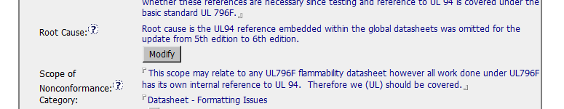
CAR 163916356 (finding)
Does the analysis support the root cause statement?
As the analysis was done and approved, it fully supports the root cause statement. BUT
Due the analysis needs more investigation.
The analysis partially supports the RC statement.
Does the analysis support the Scope of Nonconformance statement?
As well, the scope of nonconformance is partially supported by the analysis
Because the analysis is not complete

Slide 5
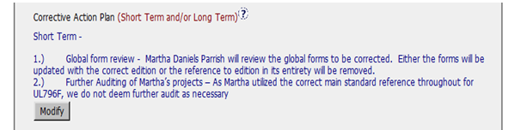
CAR 163916356 (finding)
Will the Corrective Action Plan prevent recurrence of the nonconformity?
Corrective action plan prevents partially the recurrence of the nonconformity because the datasheet for the mentioned standard are updated.
But CAP is not including the actions required in FAQ # 25 such as:
the handler found in non-compliant must receive training
verification milestone is not included.
previous six months of the handler´s records are to be reviewed.,

Slide 6
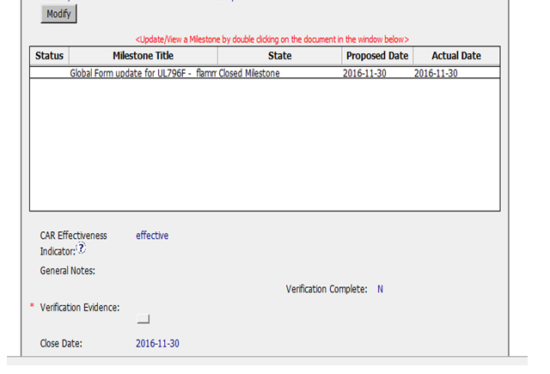
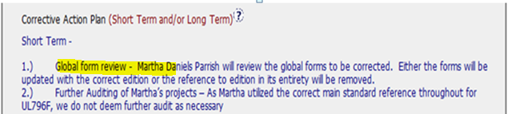
CAR 163916356 (finding)
The containment action does not stop the bleeding since containment milestone was not included
Did the containment milestone “stop the bleeding”?
Are corrective action milestones aligned to each item of the corrective action plan?
Did the verification milestone confirm the effective implementation of the corrective action plan?
The corrective action milestones
aligned fully each item of the CAP.
Only one item = one milestone
Verification milestone does not confirm the effective implementation since the verification milestone is not included in the CAP

Slide 7
Study for Finding CAR 163916356 – AP Team A
 | Team Review Criteria - Findings | Related to | Presented by
1 | ·Explain how/If the nonconformity is fully addressed in the analysis | Analysis | Larisa
2 | ·Explain how/If the analysis supports the root cause statement
3 | ·Explain how/If the analysis supports the Scope of Nonconformance statement
4 | ·Explain why/If the Corrective Action Plan will prevent the recurrence of the nonconformity | Corrective Action | JY
5 | ·Explain how/If the containment milestone “stopped the bleeding”
6 | ·Confirm that/If all corrective action milestones are aligned to each item of the corrective action plan
7 | ·Explain how/If the verification milestone confirmed the effective implementation of the corrective action plan | Verification | Catherine

Slide 8
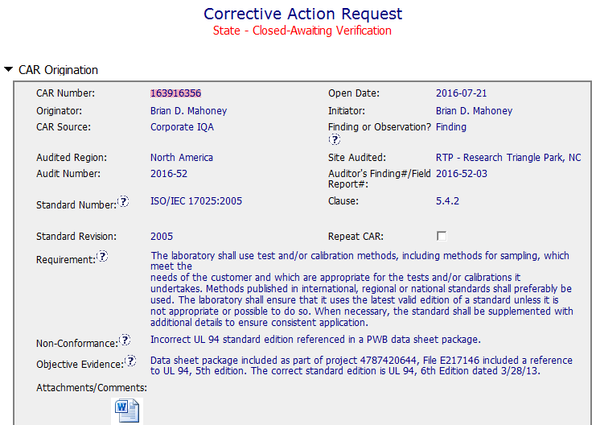
CAR# 163916356
example

Slide 9
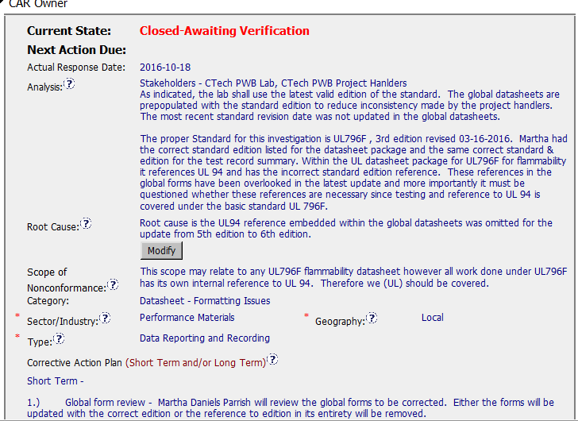
CAR# 163916356
By Larisa
 | Team Review Criteria - Findings
1 | ·Explain how/If the nonconformity is fully addressed in the analysis
2 | ·Explain how/If the analysis supports the root cause statement
3 | ·Explain how/If the analysis supports the Scope of Nonconformance statement
Notes:
Highlight key points for below criteria:
•Explain how/If the nonconformity is fully addressed in the analysis
•Explain how/If the analysis supports the root cause statement
•Explain how/If the analysis supports the Scope of Nonconformance statement

Slide 10
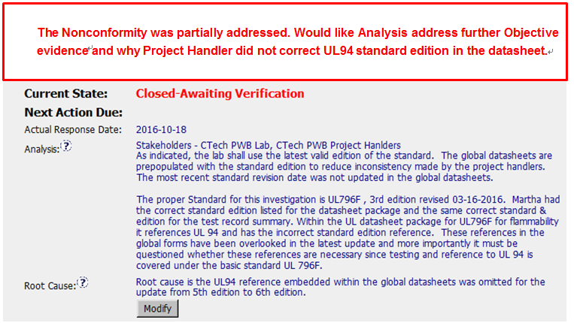
CAR# 163916356
1. Explain how/If the nonconformity is fully addressed in the analysis
Notes:
Highlight key points for below criteria:
•Explain how/If the nonconformity is fully addressed in the analysis
•Explain how/If the analysis supports the root cause statement
•Explain how/If the analysis supports the Scope of Nonconformance statement

Slide 11
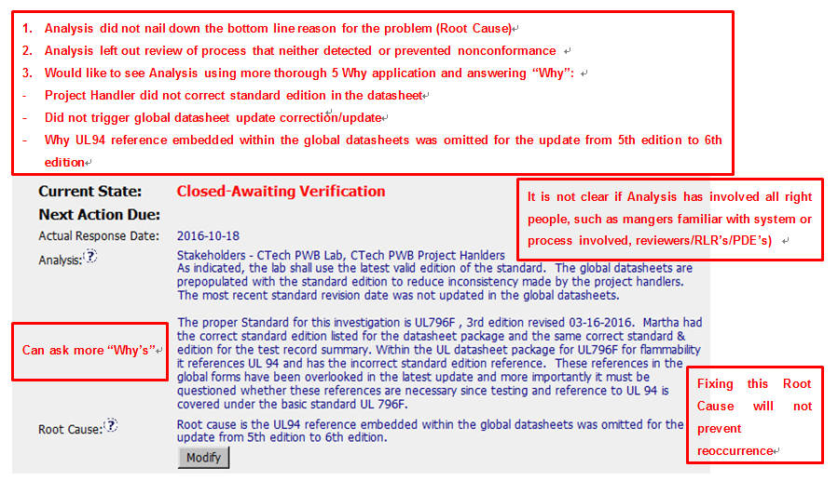
CAR# 163916356
2. Explain how/If the analysis supports the root cause statement
Notes:
Highlight key points for below criteria:
•Explain how/If the nonconformity is fully addressed in the analysis
•Explain how/If the analysis supports the root cause statement
•Explain how/If the analysis supports the Scope of Nonconformance statement

Slide 12
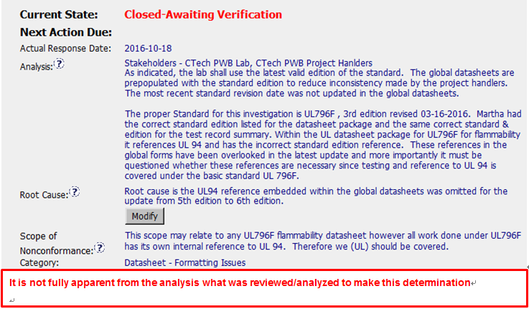
CAR# 163916356
3. Explain how/If the analysis supports the Scope of Nonconformance statement
Notes:
Highlight key points for below criteria:
•Explain how/If the nonconformity is fully addressed in the analysis
•Explain how/If the analysis supports the root cause statement
•Explain how/If the analysis supports the Scope of Nonconformance statement

Slide 13
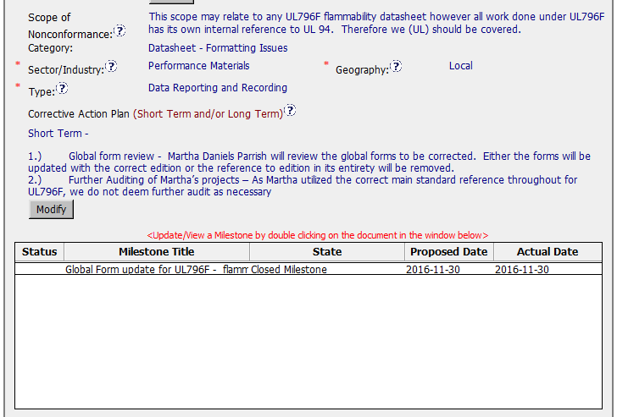
CAR# 163916356
Need mechanism to prevent recurrence.
Global form is not changed. Still the old 5th version in the milestone. Bleeding not stopped.
By JY
4 | ·Explain why/If the Corrective Action Plan will prevent the recurrence of the nonconformity
5 | ·Explain how/If the containment milestone “stopped the bleeding”
6 | ·Confirm that/If all corrective action milestones are aligned to each item of the corrective action plan
Notes:
Highlight key points for below criteria:
•Explain why/If the Corrective Action Plan will prevent the recurrence of the nonconformity
•Explain how/If the containment milestone “stopped the bleeding”
•Confirm that/If all corrective action milestones are aligned to each item of the corrective action plan

Slide 14
CAR# 163916356
This is a Finding CAR, however no action for the verification. CAR Owner& Champion disregarded comment provided in the area of “CAR origination”.
Suggestion: a verification action should be added, e.g. to randomly check new projects if the new form works, etc.
By Catherine
7 | ·Explain how/If the verification milestone confirmed the effective implementation of the corrective action plan
Notes:
Highlight key points for below criteria:
•Explain how/If the verification milestone confirmed the effective implementation of the corrective action plan

Slide 15
CAR# 163916356 – CAR Review Criteria Check
CAR Review Criteria | Fully | Partially | Not at all | N/A
•Is the nonconformity fully addressed in the analysis? |  | √
•Does the analysis support the root cause statement? |  | √
•Does the analysis support the Scope of Nonconformance statement |  | √
•Will the Corrective Action Plan prevent recurrence of the nonconformity? |  | √
•Did the containment milestone “stop the bleeding”? |  | √
•Are corrective action milestones aligned to each item of the corrective action plan? |  | √
•Did the verification milestone confirm the effective implementation of the corrective action plan? |  |  | √

